Slide 1

Team mandarine
Presents:
Project “Movies statistic app”

Slide 2
Javascript UI & DOM online team “MANDARINE ”
*All team members took part in the creation of the app.
Member name : | User name in Telerik Academy:
Petar Velkov | kidroca
Yordanka Petkova | yori_to
Ivan Ivanov | Acrelion
Todor Dimitrov | TodorDimitrov
Peruna Keremidchieva | peruna
Svilen Ukalski | snukal
Hristo Vasilev | vasilevhr
Nikolay Kumanov | NP.Kumanov
Filip Anestiev | panestiev

Slide 3
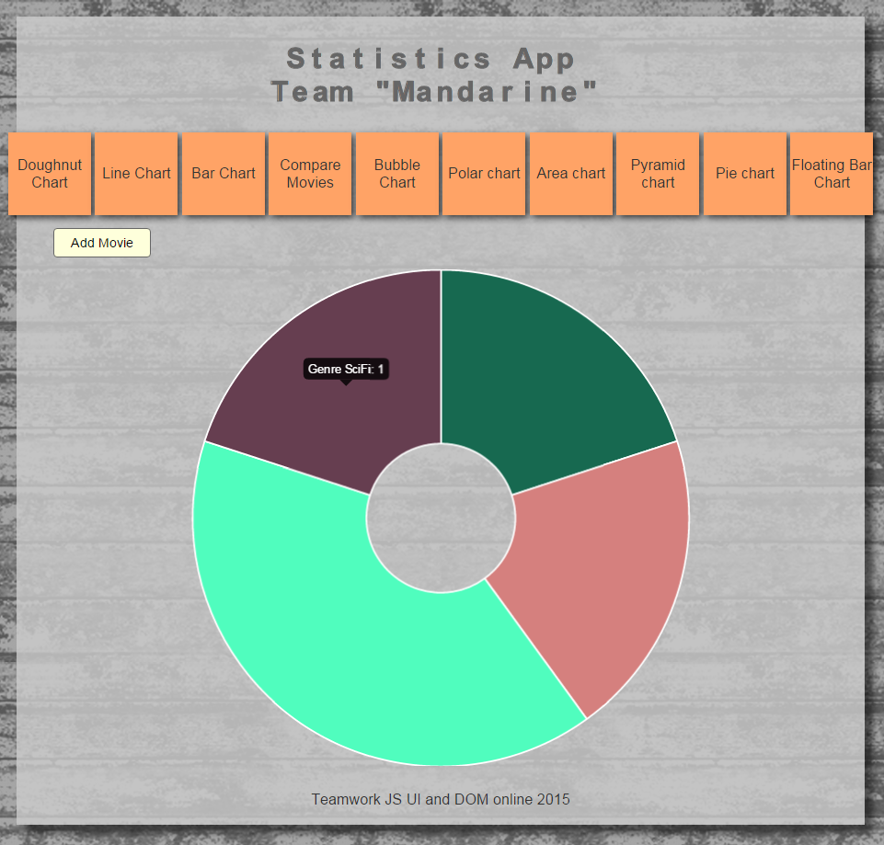
What does the “Movies Statistic app do?”
The goal of the app is to draw charts based on given data.
The theme is “movies” – the app visually compares different movies – based on drama factor, ticket price, action factor and so on.

Slide 4
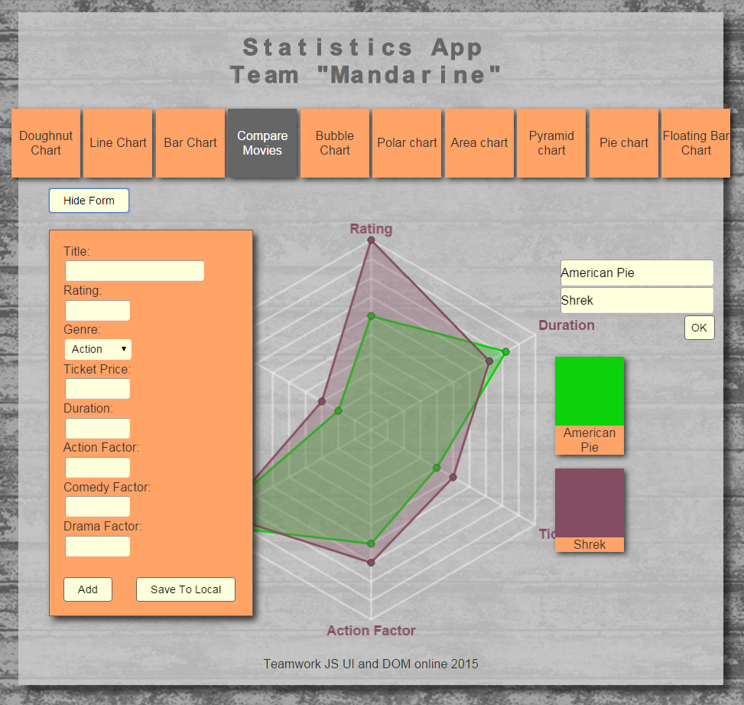
OVERALL
The app:
Has 10 different charts Has its own database with movies and at the moment almost all of the charts can work with it You can add a new movie with detailed info – name, genre, ticket price etc. and it’s added to the data base At the moment half of the charts work with the new movie

Slide 5
THE CHARTS
Name | Brief description / compares movies based on: | Used library
Doughnut Chart | genre, works with database and new added movies | ChartJS
Line Chart | t. price and drama factor , works with database and new added movies | ChartJS
Bar Chart | box office gross , works with its own data | CanvasJS jQuery
Radar Chart | all factors, works with database and new added movies, can change movies with button | ChartJS jQuery
Bubble Chart | by rating, works with database and new added movies | CanvasJS
Polar Chart | comedy factor, works with database | ChartJS
Area Chart | genre through years, works with its own data | CanvasJS
Pyramid Chart | ticket price, works with its own data | Highcharts

Slide 6
THE CHARTS
Name | Brief description / compares movies based on: | Used library
Pie Chart | action factor, works with database and new added movies | Raphael JS g.raphael.js
Floating Bar Chart | genre, works with database and new added movies | CanvasJS

Slide 7
GENERAL REQUREMENTS INFO
Use of CanvasJS, ChartJS
Use of Raphael JS , highcharts
Created animation with Raphael JS
The app works with the latest browsers: Chrome, Mozilla Firefox, Opera, Apple Safari

Slide 8
GITHUB REPOSITORY ADDRESS
https://github.com/kidroca/JS-Teamwork-Mandarine

